Slide 1

Video Forgery
Detection
MCA main project:
Neema Poulose
MCA-B Roll No 23

Slide 2
01
Relevance of the project
02
Objective of the Project
03
A Description of the Project
04
Existing System and Proposed System
Contents
CONTENTS
05
Modules.
06
UI design
07
About User interface design and Back-end design

Slide 3
01
Relevance of topic
Contents

Slide 4
Relevance of the project
The trustworthiness of digital media is decreasing due to the fact that it has become really easy to alter and tamper the digital content flawlessly and thus, there is a need to verify the originality and authenticity of media contents. In view of this problem, this project is a method to classify the object based-
forged content.

Slide 5
02
Objective of the Project
Contents

Slide 6
Objective
To develop an approach for automatic identification of object-based forged video which is encoded with advanced frameworks based on its GOP (Group Of Pictures) structure.

Slide 7
03
Description of the Project
Contents

Slide 8
Generally, videos are in compressed format. Therefore, when a pristine video undergoes some kinds of object-based forgery, the first step is to decompress it to a sequence of individual frames and each frame can be regarded as a still image. Then the frames in the selected segments of the sequence are tampered while the rest frames remain untouched. After all the manipulations are finished, the resulting frame sequence is re-compressed to generate a forged version.

Slide 9
Object-based forgery adds new objects to a video scene or removes existing objects from it. To generate a forged video:
1.Decompress the video into individual frames and each frame is regarded as a still image.
2.The frames in the selected segments of the sequence are tampered while the rest frames remain untouched.
3.The resulting frame sequence is re-compressed to generate a forged version.

Slide 10
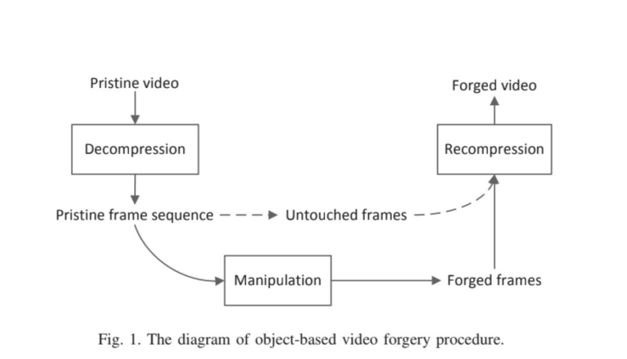

Slide 11
04
Existing System and Proposed System
Contents

Slide 12
Existing System
Various methods such as active and passive methods can be used but passive approach have proven to be more effective than the active methods as they do not interfere with the video in any way. These techniques are used to find many tampering types like double compression, frame duplication , frame deletion , and multiple compression. It proves that it is less effective in terms of accuracy and time.

Slide 13
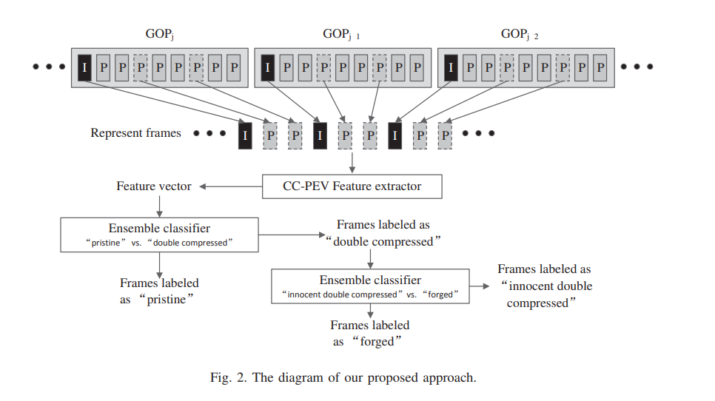
Proposed System

Slide 14
Methodology
Select represent frames and construct their motion residuals. Extract feature vector for each motion residual. Feature vector acts as an input to Ensemble classifier which judges an input frame as “forged” or “innocent double compressed”. A GOP structure is marked as “forged” if all the represent I frames and P/B frames are labeled as “forged” by the “innocent double compressed” vs. “forged” classifier. If there are at least one “forged” GOP structure in the suspicious video clip, it is considered to be a forged video clip, otherwise the suspicious video clips is indeed an innocent double compressed one.

Slide 15
05
Modules
Contents

Slide 16
Modules
2. Extracting videos
into individual frames
1.Registration
3.Feature Extraction
4. Testing and classification

Slide 17
06
UI Design
Contents

Slide 18
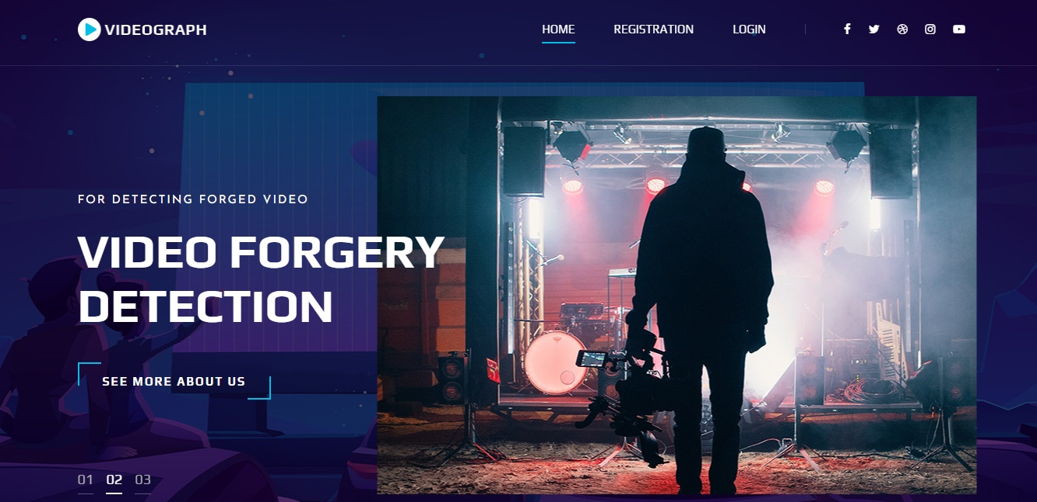

Slide 19
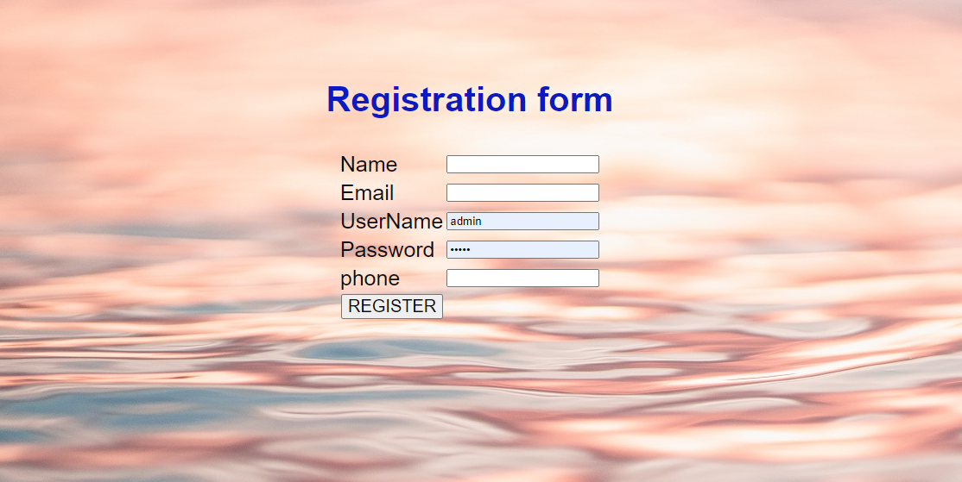
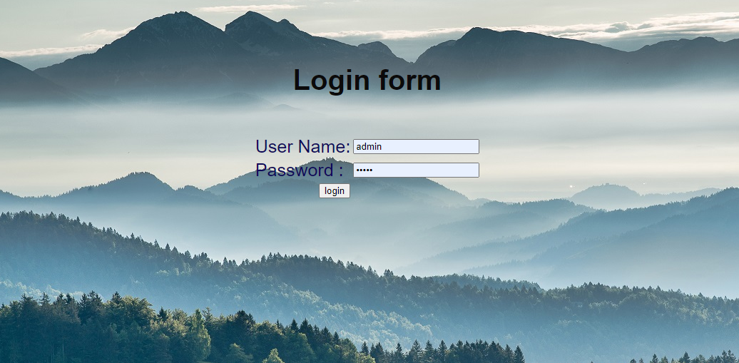

Slide 20

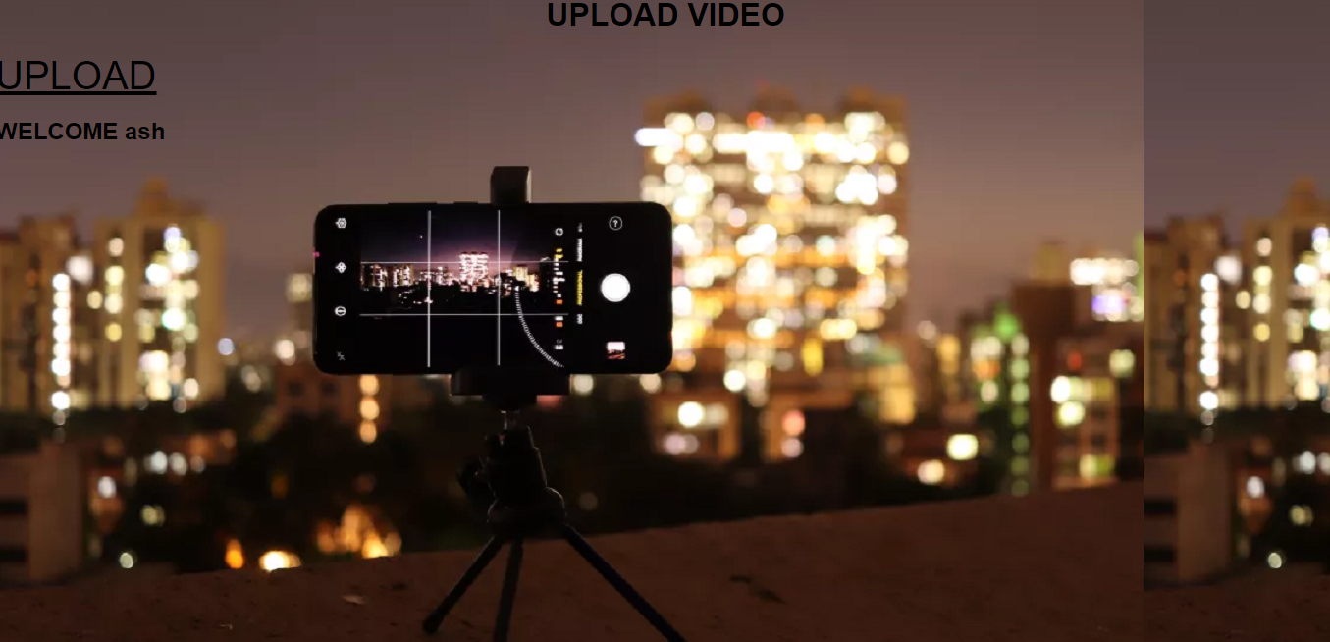

Slide 21
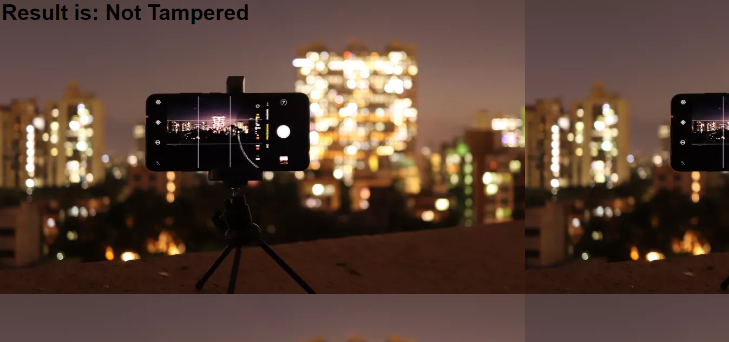
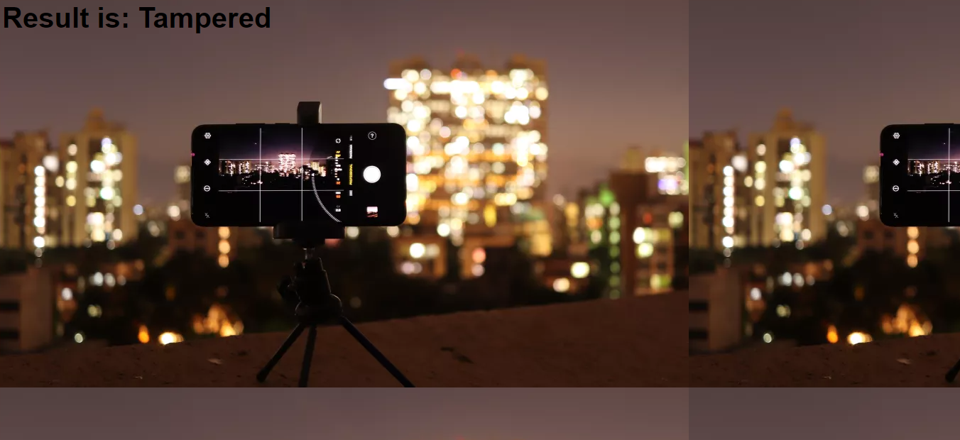

Slide 22
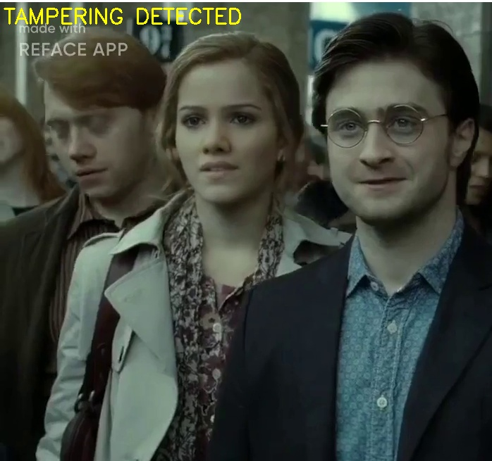

Slide 23
07
About User interface design and Back-end design
Contents

Slide 24
User interface design and Back-end design
PYTHON
FLASK
Django
HTML/CSS
PYTHON
Reasons for using the Python language in this project is due to its simple syntax, the development of applications with Python is fast when compared to many programming languages.
FLASK
Flask Tutorial provides the basic and advanced concepts of the Python Flask framework. Our Flask tutorial is designed for beginners and professionals.
Django
HTML AND CSS
HTML is Hypertext Markup Language. CSS is Cascading Style Sheet language. HTML is used to structure the content on the web page. CSS is used to add style to the content of a web page.
Django is a back-end server side web framework.
Django is free, open source and written in Python.
Django makes it easier to build web pages using Python.

Slide 25
Future Scope
In the future we can use real time videos to detect the copy
and paste part with the help of frames and masking.To detect these different techniques can be applied like ﻿ DCT, correlation and filters. ﻿ It can also extended on the real time crime department ﻿ videos. So that the criminal will be easily identified. It can ﻿ also extended with the help of Other techniques so that the ﻿ better results may be produced.﻿

Slide 26
Referances
[1] A. Rocha, W. Scheirer, T. Boult, and S. Goldenstein, “Vision of the unseen: current trends and challenges in digital image and video forensics,” ACM Computing Surveys, vol. 43, no. 4, pp. 26–40, 2011.
[2] D. Liao, R. Yang, H. Liu, et al., “Double H.264/AVC compression detection using quantized nonzero AC coefficients,” in Proc. SPIE, Media Watermarking, Security, and Forensics III , 78800Q, 2011.
[3] M.C. Stamm, W.S. Lin, and K.J.R. Liu, “Temporal forensics and antiforensics for motion compensated video,” IEEE Trans. Inf. Forensics Security, vol. 7, no. 4, pp. 1315–1329, 2012.
[4] J. Zhang, Y. Su, and M. Zhang, “Exposing digital video forgery by ghost shadow artifact,” in Proc. 1st ACM Workshop on Multimedia in Forensics, (MiFor 09), pp. 49–54, 2009.

Slide 27
THANK YOU

